Slide 1

Cat

Slide 2
The Evolution of Felines: From Wild Ancestors to Domesticated Companions
Felines trace their lineage back to wild ancestors, such as the African wildcat, known for their solitary and adaptable nature. Over millennia, natural selection favored traits that facilitated survival, hunting, and camouflage. Human intervention played a pivotal role in their domestication, as ancient civilizations gradually tamed them for pest control and companionship. This symbiotic relationship led to the development of various domesticated breeds, each exhibiting unique characteristics, yet retaining the instinctual behaviors and physical prowess of their wild forebears.

Slide 3
Understanding Feline Behavior: What Makes Cats Tick?
Cats are enigmatic creatures, known for their independent yet affectionate nature. Understanding feline behavior involves recognizing their instincts and environmental stimuli. Cats communicate through body language, vocalizations, and scent markings. Their predatory instincts drive behaviors like pouncing and stalking. Socially, cats are territorial yet can form close bonds with humans and other animals. Stress, often caused by changes in routine or environment, can affect behavior, making understanding these aspects crucial for harmonious coexistence.

Slide 4
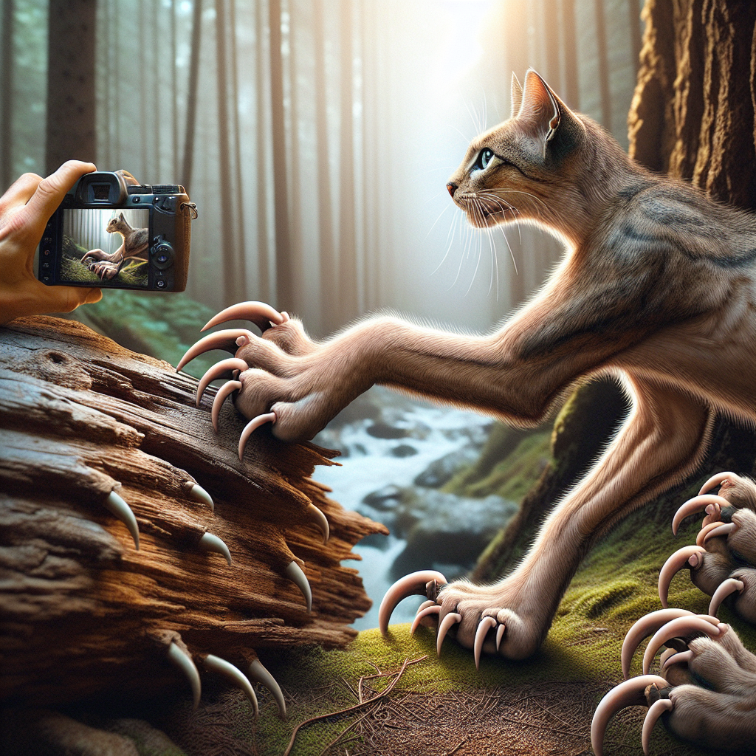
The Anatomy of a Cat: Unique Features and Adaptations
Cats possess several unique anatomical features that contribute to their survival and adaptability. Their retractable claws allow them to climb and catch prey efficiently, while their flexible spine provides remarkable agility and balance. The structure of a cat's eyes enables excellent night vision, a trait crucial for nocturnal hunting. Additionally, their highly sensitive whiskers help detect subtle changes in the environment, guiding them through tight spaces. These adaptations make cats exceptional hunters and agile companions.

Slide 5
Popular Cat Breeds: Characteristics and Traits
Siamese Cats
Siamese cats are known for their striking blue almond-shaped eyes and sleek, short coats. They are highly social and vocal, often 'talking' to their owners in a distinctive voice. Siamese cats are intelligent and playful, making them great companions for interactive play. They form strong bonds with their human families and thrive on attention and engagement.
Maine Coon Cats
Maine Coon cats are one of the largest domesticated cat breeds, characterized by their long, bushy tails and tufted ears. They have a friendly and gentle disposition, often referred to as 'gentle giants.' Maine Coons are adaptable and get along well with children and other pets, making them ideal family pets. They require regular grooming due to their thick, long fur.
Persian Cats
Persian cats are famous for their long, luxurious coats and flat, pansy-like faces. They are known for their calm and affectionate nature, enjoying a relaxed lifestyle. Persians require daily grooming to maintain their coat's condition and should be kept indoors to maintain their health. Despite their laid-back demeanor, they enjoy gentle play and attention from their human companions.

Slide 6
Feline Nutrition: What to Feed Your Cat for Optimal Health
Providing your cat with a balanced diet is crucial for maintaining optimal health. Cats are obligate carnivores, requiring high-protein diets primarily derived from animal sources. Essential nutrients include taurine, arachidonic acid, and vitamin A, which are naturally found in meat. Avoid feeding cats plant-based diets, as they lack necessary nutrients. Fresh water should always be available to prevent urinary issues. Consultation with a veterinarian can ensure dietary needs are met, promoting longevity and wellbeing.

Slide 7

The Role of Cats in Various Cultures and Mythologies
Cats have held significant roles in numerous cultures and mythologies throughout history. In ancient Egypt, cats were revered as sacred beings, often associated with the goddess Bastet, symbolizing protection and fertility. Similarly, Norse mythology features the goddess Freyja, whose chariot was pulled by cats, representing beauty and love. In Japanese folklore, the Maneki-neko, or 'beckoning cat,' is believed to bring good fortune and prosperity to its owners. These cultural depictions highlight cats' diverse symbolic importance across civilizations.

Slide 8
Cat Communication: Decoding Purrs, Meows, and Body Language
The Meaning of Purrs
Cats often purr when they are content, but this sound can also indicate other emotions. A happy cat might emit a soft, rhythmic purr, while a louder, more urgent purr can signal distress or pain. Interestingly, cats may also purr to self-soothe or to solicit care from their owners. Observing the context in which a cat purrs can provide valuable insights into its emotional state.
Interpreting Meows
Cats use meows primarily to communicate with humans. The pitch and frequency can vary depending on the cat's needs. A high-pitched, repetitive meow might indicate hunger or a desire for attention, while a low-pitched meow can suggest dissatisfaction. By paying attention to variations in meowing, cat owners can better understand what their feline friends are trying to convey.
Understanding Body Language
Body language is a crucial aspect of feline communication. A cat's tail, ears, and posture can signal various emotions. For example, a raised tail often shows friendliness, while flattened ears may indicate fear or aggression. Observing these physical cues, alongside vocal signals, provides a comprehensive understanding of what a cat is experiencing or trying to express.

Slide 9
Health and Wellness: Common Cat Ailments and Prevention
Cats, like any other pets, are prone to various health issues, including fleas, obesity, and dental diseases. Regular veterinary checkups and vaccinations are crucial for early detection and prevention of illnesses. Maintaining a balanced diet and ensuring routine grooming can help keep your cat healthy. Providing a stress-free environment with plenty of exercise and mental stimulation also contributes significantly to feline well-being. Understanding these common ailments and preventive measures ensures your cat leads a long, healthy life.

Slide 10
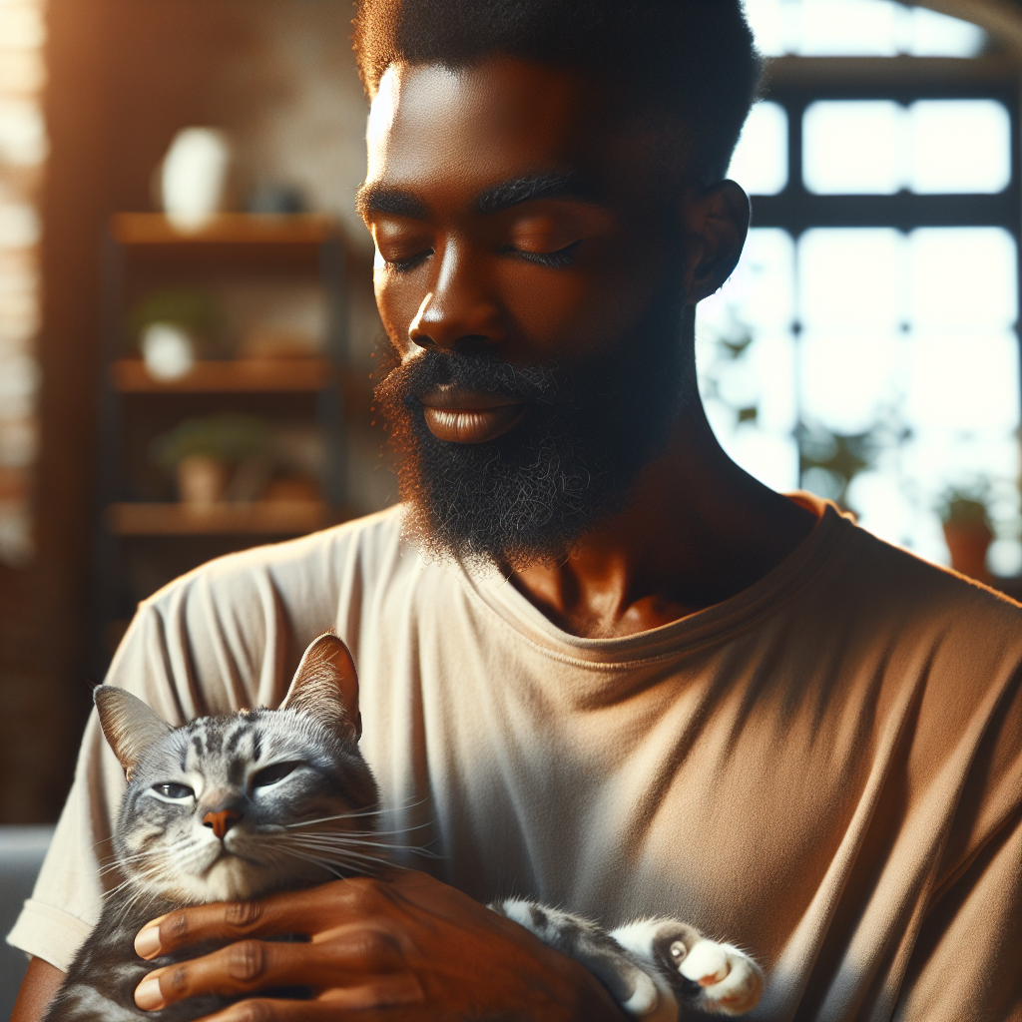
The Impact of Cats on Human Health and Wellbeing
Cats positively influence human health and wellbeing in several ways. Their companionship helps reduce stress and anxiety, leading to improved mental health. The rhythmic sound of a cat's purr can induce relaxation, lowering blood pressure and promoting cardiovascular health. Additionally, caring for a cat fosters a sense of responsibility and routine, which can enhance overall life satisfaction. Studies have shown that interactions with cats can increase levels of serotonin and dopamine, chemicals that boost mood.

Slide 11
The Art of Cat Care: Grooming, Environment, and Enrichment
Grooming Essentials
Regular grooming is crucial for a cat's health and comfort. It helps reduce shedding and prevents the formation of hairballs. Using appropriate brushes and combs suited to your cat's fur type can make grooming more effective. Additionally, routine grooming provides an opportunity to check for fleas, ticks, and skin issues. Establishing a grooming schedule helps cats get accustomed to the process, reducing stress for both the pet and owner.
Creating a Cat-Friendly Environment
A cat's environment significantly impacts its wellbeing. Safe spaces, such as cozy beds or elevated perches, offer comfort and security. Ensure the surroundings are enriched with scratching posts, climbing trees, and hideaways to encourage natural behaviors. A clean environment, free from hazards and toxins, is essential. Regularly changing the layout or introducing new elements can stimulate curiosity and prevent boredom.
Enrichment Activities
Enrichment is key to a cat's mental and physical health. Interactive toys, puzzle feeders, and play sessions encourage exercise and mental stimulation. Rotate toys frequently to maintain interest. Training sessions, using positive reinforcement, can strengthen the bond between cat and owner while teaching new skills. Observing your cat's preferences and tailoring activities to their interests can enhance the enrichment experience, promoting a happier and healthier life.

Slide 12
E'tiboringiz uchun rahmat!

